Slide 1
Project Title Proposal Presentation
REVA Academy for Corporate Excellence (RACE)
Name:
Program:
Batch:
SRN:
Date:
Capstone 1/2:
race.reva.edu.in

Slide 2
Agenda
01
Introduction
05
Project Methodology
Background | Current status | Why this study
Conceptual Framework | Research Design
02
Literature Review
06
Proposed Solution
Seminal works | Summary | Research Gap
Solution Approach | Expected Outcome
03
Problem Statement
07
Detailed Scope of Work
Technical/Functional Problem
08
References
04
Project Objectives
Journal Articles | White Papers
Primary & Secondary Objectives | Expected Outcome

Slide 3
General Instructions
This slide is for reference only and must be removed while submitting the final deck. Text in Red in all slides is for reference only and must be removed.
Present a clear and logical flow — Problem, Objectives, Methodology, Implementation, Results, and Conclusion.
Keep slides visual, concise, and consistent in design; use diagrams, charts, and images instead of long text.
Highlight measurable outcomes and insights that directly link to project objectives.
Conclude with key learnings, future improvements, and acknowledgements.
Bring Design Thinking: You must bring design thinking principles while designing your deck.
In the introductory section, bring the stakeholders' points of view and their pain points
Highlight Human-Centred Approach: Show that your project started with understanding real user needs (Empathise → Define → Ideate → Prototype → Test).
Link Stages to Project Flow: Briefly align each stage with what you did — problem understanding, idea generation, model prototyping, and user validation.
Use Visual Storytelling: Add short visuals like personas, journey maps, and prototype screenshots to make your process clear and engaging.
Notes:
Use Roboto Slab as a consistent font throughout
You are free to change the standard template headings to customised ones as per your project.

Slide 4
Background Information
Background:
Active Directory functions as the primary identity and access management system in enterprise
environments. Directory configuration controls authentication, authorization, and resource access.
Industry experience indicates that maintaining Active Directory security presents operational
challenges. Security assessments such as Active Directory penetration testing require
specialized expertise and significant financial investment. Concerns regarding operational impact discourage frequent assessments.
These challenges motivate the development of an automated approach for identifying
Active Directory misconfigurations and improving security visibility.

Slide 5
Background Information
Current Status:
Several tools support Active Directory enumeration and attack path analysis. These tools identify permission relationships and configuration weaknesses. Structured classification of misconfigurations into standardized adversarial techniques remains limited. Security teams often lack continuous visibility into identity-based security exposure. Misconfigurations remain undetected between assessment cycles.
This study aims to develop an automated framework that identifies Active Directory misconfigurations and maps findings to MITRE ATT&CK techniques to improve identity security visibility.

Slide 6
Background Information
Why this study?
Feedback from an industry professional indicated that managing Active Directory security presents practical challenges. Active Directory penetration testing requires specialized expertise and involves significant cost.
Regular testing is difficult to perform in many organizations.Concerns about possible operational impact reduce the frequency of security assessments. As a result, security teams may not have clear visibility into Active Directory misconfigurations.
This study focuses on developing an automated approach for identifying Active Directory misconfigurations and improving visibility into identity-related security risks.

Slide 7
Literature Review
No. | Title | Author and Year | Journal | Description | Insights | Research Gaps/Comments
1 | BloodHound: Six Degrees of Domain Admin | A. Robbins et al., 2016 | SpecterOps | This work introduces BloodHound, a tool that analyzes relationships between users, groups, and permissions in Active Directory. The tool helps identify possible privilege escalation paths. | The study shows that attack path analysis helps in understanding privilege escalation risks in Active Directory environments. | The work focuses on attack path visualization. Structured mapping of misconfigurations to MITRE ATT&CK techniques is not included.
2 | Kerberos Security and Credential Abuse in Enterprise Networks | D. B. Lipp et al., 2019 | IEEE European Symposium on Security and Privacy Workshops | This paper explains credential extraction techniques such as Kerberoasting and describes weaknesses in Kerberos authentication. | The study shows that credential attacks are possible due to configuration weaknesses in enterprise environments. | The paper explains attack techniques but does not provide automated methods for identifying misconfigurations.
3 | Practical Privilege Escalation in Enterprise Authentication Systems | M. Schwarz et al., 2019 | IEEE Security & Privacy | This paper studies privilege escalation techniques related to authentication and delegation settings in enterprise environments. | The study highlights the security risks caused by improper permission and delegation settings. | The research discusses attack techniques but does not include automated detection or structured classification.
4 | MITRE ATT&CK: A Knowledge Base of Adversary Tactics and Techniques | MITRE Corporation, 2023 | MITRE | This work presents the MITRE ATT&CK framework that describes attacker tactics and techniques in enterprise environments. | The framework provides a standard method for describing attacker techniques and security risks. | Direct mapping between Active Directory misconfigurations and MITRE ATT&CK techniques is not covered.
5 | Graph-Based Modeling of Enterprise Identity Attack Surfaces | N. Huaman et al., 2020 | IEEE Conference on Communications and Network Security | This paper presents a method for analyzing identity-related attack surfaces using graph-based models. | The study shows that identity relationships can be analyzed to understand security exposure. | The research focuses on modeling approaches and does not include a practical detection tool.

Slide 8
Problem Statement
Technical Problem:
Existing tools help identify Active Directory misconfigurations and permission weaknesses, but interpreting the security impact requires manual effort.Clear understanding of attacker techniques based on misconfigurations remains limited. Configuration issues may remain unnoticed between assessment cycles.
Functional Problem:
Active Directory security assessments rely on penetration testing and manual reviews. These activities require specialized skills and involve significant cost.Regular assessments are difficult to maintain. As a result, security teams may not have a clear view of Active Directory misconfigurations.

Slide 9
Project Objectives
3-4 Objectives with action verbs | Expected Outcome
Develop an automated framework to collect Active Directory configuration and permission data
Identify identity and permission-based misconfigurations in Active Directory environments
Map detected misconfigurations to relevant MITRE ATT&CK techniques
Generate structured reports summarizing misconfigurations and associated security risks

Slide 10
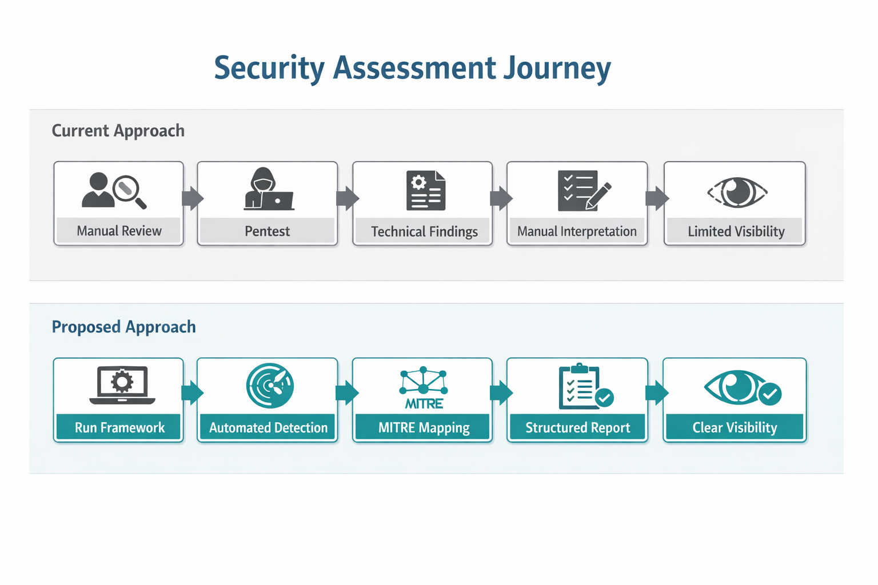
Project Methodology
Conceptual Framework | Research Design

Slide 11
Proposed Solution
Solution Approach | Expected Outcome

Slide 12
References
Journal Articles | White Papers cited in IEEE format

Slide 13


